Slide 1
Behavior Design Pattern (1)
Parinya Ekparinya
Parinya.Ek@kmitl.ac.th
Software Architecture and Design

Slide 2
Acknowledgement
The content of the following slides are partially based on the listed material as follows:
Object-Oriented Patterns & Frameworks by Dr. Douglas C. Schmidt
https://en.wikipedia.org/wiki/Iterator_pattern
https://en.wikipedia.org/wiki/Observer_pattern
https://en.wikipedia.org/wiki/Mediator_pattern
https://en.wikipedia.org/wiki/Interpreter_pattern
https://en.wikipedia.org/wiki/Null_Object_pattern

Slide 3
WARNING: Overuse of design patterns can lead to code that is downright over-engineered. Always go with the simplest solution that does the job and introduce patterns only where the need emerges.
Freeman, E., Robson, E., Bates, B., & Sierra, K. (2008). Head first design patterns. " O'Reilly Media, Inc."

Slide 4
Behavior Design Patterns
Iterator
Observer
Mediator
Interpreter
Null Object
Command
Strategy
State
Visitor
Template Method

Slide 5


Iterator

Slide 6
Iterator: Problem
The elements of an aggregate object should be accessed and traversed without exposing its representation (data structures).
New traversal operations should be defined for an aggregate object without changing its interface.
Applicability
Require multiple traversal algorithms over an aggregate
Require a uniform traversal interface over different aggregates
When aggregate classes & traversal algorithm must vary independently

Slide 7
Iterator: Solution
Intent
Access elements of an aggregate (container) without exposing its representation.
What solution does the Iterator design pattern describe?
Define a separate (iterator) object that encapsulates accessing and traversing an aggregate object.
Clients use an iterator to access and traverse an aggregate without knowing its representation (data structures).

Slide 8
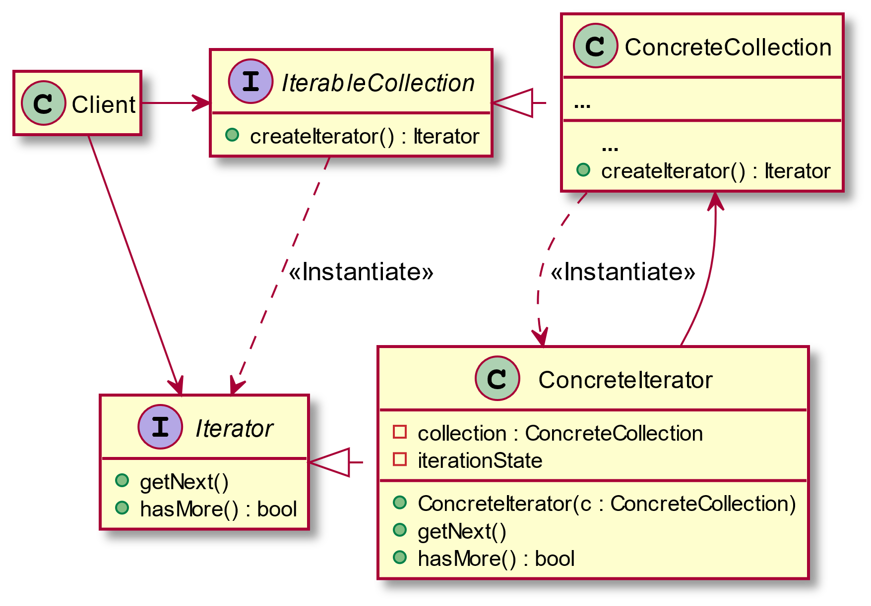

Slide 9
Iterator: Consequences
Flexibility: aggregate & traversal are independent.
Support multiple iterators & multiple traversal algorithms.
Incur additional communication overhead between iterator & aggregate. This is particularly problematic for iterators in concurrent or distributed systems.

Slide 10
Iterator: Examples
Iterator (refactoring.guru)
Iterator pattern – Wikipedia
Iterator Design Pattern in Java – JournalDev

Slide 11

Observer
Also known as: Event-Subscriber, Listener

Slide 12
Observer: Problem
A one-to-many dependency between objects should be defined without making the objects tightly coupled.
It should be ensured that when one object changes state, an open-ended number of dependent objects are updated automatically.
It should be possible that one object can notify an open-ended number of other objects.
Applicability
An abstraction has two aspects, one dependent on the other.
A change to one object requires changing untold others.
An object should notify unknown other objects.

Slide 13
Observer: Solution
Intent
Define a one-to-many dependency between objects so that when one object changes state, all dependents are notified & updated.
What solution does the Observer design pattern describe?
Define Subject and Observer objects.
So that when a subject changes state, all registered observers are notified and updated automatically (and probably asynchronously).

Slide 14
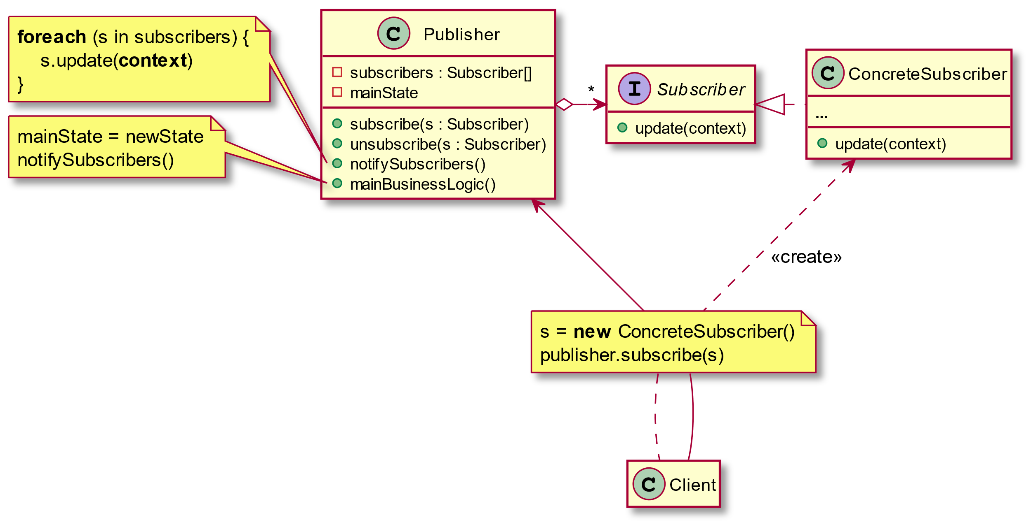

Slide 15
Observer: Consequences
Modularity: subject & observers may vary independently.
Extensibility: can define & add any number of observers.
Customizability: different observers offer different views of subject.
Unexpected updates: observers don’t know about each other.
Update overhead: might need hints or filtering.

Slide 16
Observer: Examples
Observer (refactoring.guru)
Observer pattern – Wikipedia
Observer Design Pattern in Java – JournalDev

Slide 17

Mediator
Also known as: Intermediary, Controller

Slide 18
Mediator: Problem
Tight coupling between a set of interacting objects should be avoided.
It should be possible to change the interaction between a set of objects independently.
Applicability
A set of objects communicate in well-defined but complex ways. The resulting interdependencies are unstructured and difficult to understand.
Reusing an object is difficult because it refers to and communicates with many other objects.
A behavior that's distributed between several classes should be customizable without a lot of subclassing.

Slide 19
Mediator: Solution
Intent
Define an object that encapsulate show a set of objects interact. Mediator promotes loose coupling by keeping objects from referring to each other explicitly, and it lets you vary their interaction independently.
What solution does the Mediator design pattern describe?
Define a separate (mediator) object that encapsulates the interaction between a set of objects.
Objects delegate their interaction to a mediator object instead of interacting with each other directly.

Slide 20
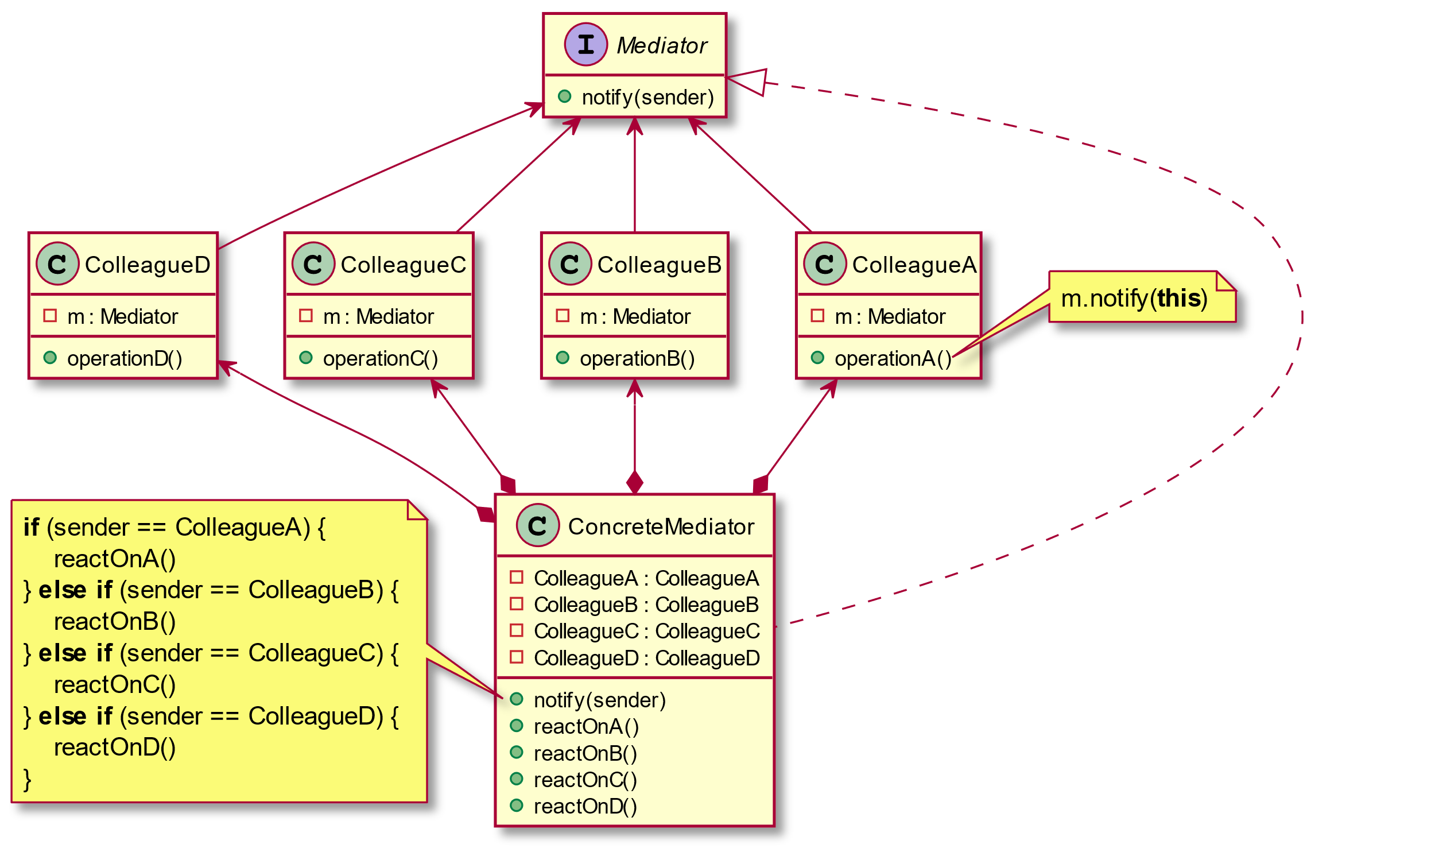

Slide 21
Mediator: Consequences
Limits subclassing. Changing the behavior requires subclassing Mediator only; Colleague classes can be reused as is.
Modularity: Colleague & Mediator classes can be varied and reused independently.
Simplifies object protocols. A mediator replaces many-to-many with one-to-many interactions.
trades complexity of interaction for complexity in the mediator. This can make the mediator itself a monolith that's hard to maintain.

Slide 22
Mediator: Examples
Mediator (refactoring.guru)
Mediator pattern - Wikipedia
Mediator Design Pattern in Java – JournalDev

Slide 23

Interpreter

Slide 24
Interpreter: Problem
If a particular kind of problem occurs often enough, then it might be worthwhile to express instances of the problem as sentences in a simple language.
A grammar for a simple language should be defined so that sentences in the language can be interpreted.
Applicability
When the grammar is simple & relatively stable.
Efficiency is not a critical concern.

Slide 25
Interpreter: Solution
Intent
Given a language, define a representation for its grammar along with an interpreter that uses the representation to interpret sentences in the language.
What solution does the Interpreter design pattern describe?
Define a grammar for a simple language by defining an Expression class hierarchy and implementing an interpret() operation.
Represent a sentence in the language by an abstract syntax tree (AST) made up of Expression instances.
Interpret a sentence by calling interpret() on the AST.

Slide 26
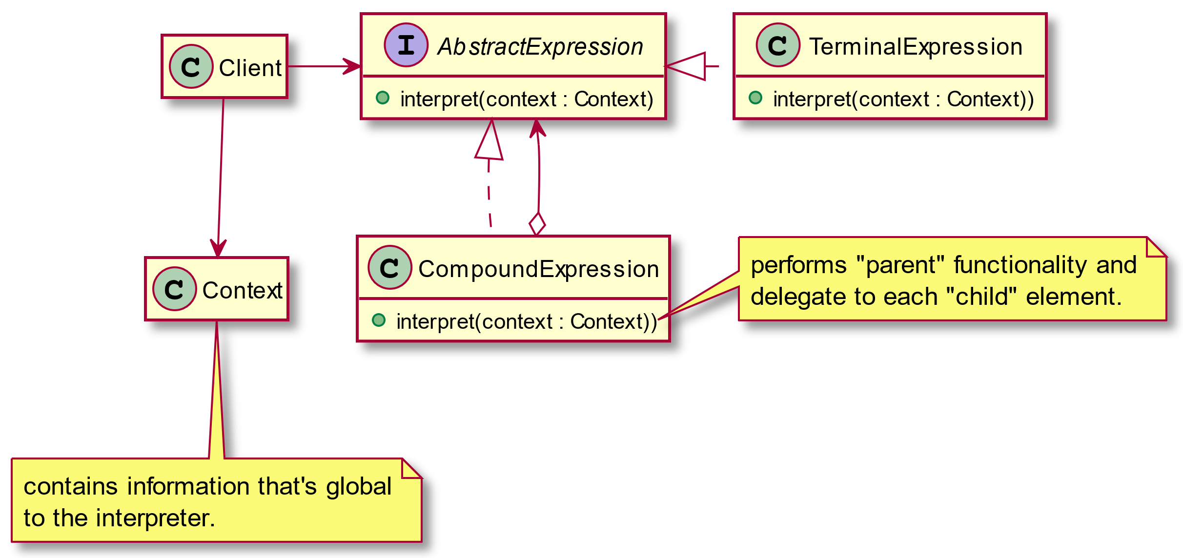

Slide 27
Interpreter : Consequences
Simple grammars are easy to change & extend, e.g., all rules represented by distinct classes in an orderly manner.
Adding another rule adds another class.
Complex grammars are hard to implement & maintain, e.g., more interdependent rules yield more interdependent classes.

Slide 28
Interpreter : Examples
Interpreter pattern – Wikipedia
Interpreter Design Pattern (sourcemaking.com)
Iterator Design Pattern in Java – JournalDev

Slide 29

Null Object

Slide 30
Null Object: Problem
In most object-oriented languages, references may be null.
These references need to be checked to ensure they are not null before invoking any methods, because methods typically cannot be invoked on null references.
How can the absence of an object — the presence of a null reference — be treated transparently?
Applicability
An object requires a collaborator.
Some collaborator instances should do nothing.
You want to abstract the handling of null away from the client.

Slide 31
Null Object: Solution
Intent
Provide an object as a surrogate for the lack of an object of a given type.
What solution does the Null Object design pattern describes?
The uses of a Null Object, an object with no referenced value or with defined neutral ("null") behavior.
The behavior (or lack thereof) of such objects.

Slide 32
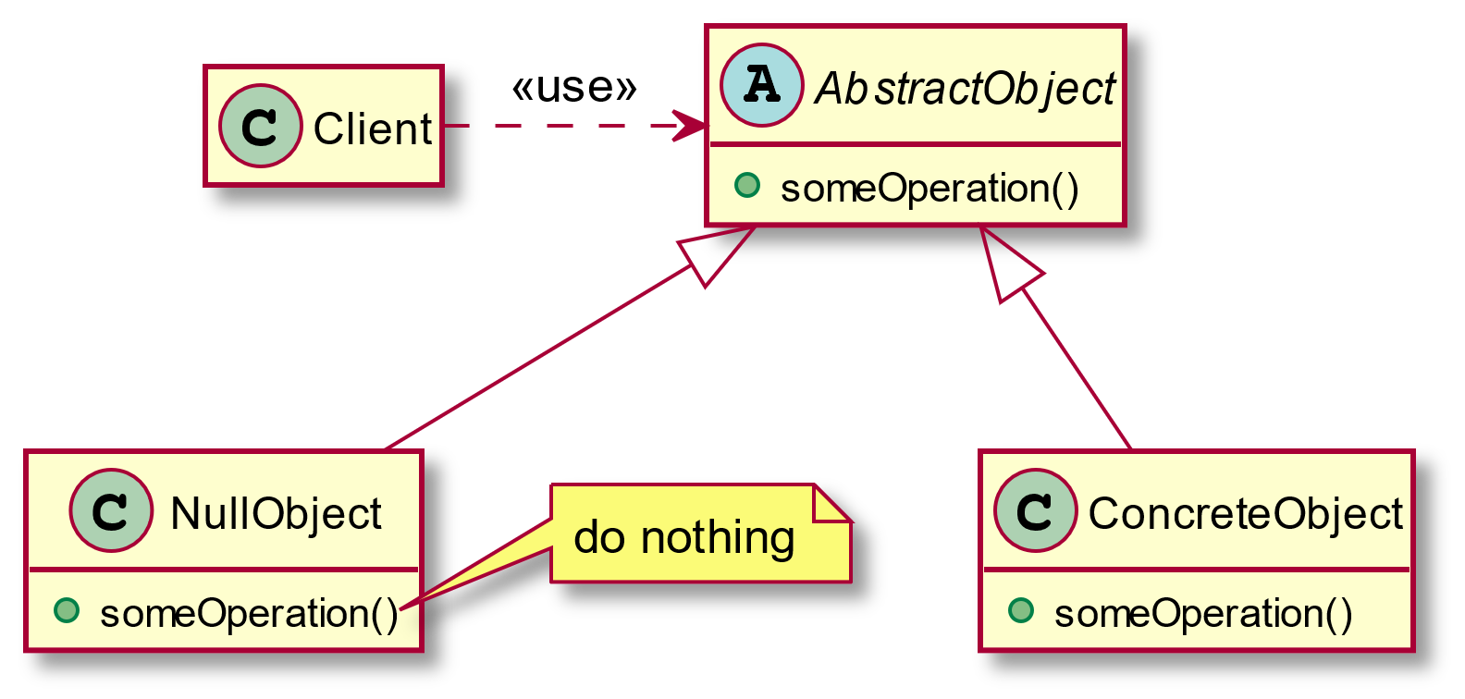

Slide 33
Null Object: Consequences
Simplifies client code, because it avoids having to write testing code which handles the null collaborator specially.
Can be difficult to implement if various clients do not agree on how the null object should do nothing as when your AbstractObject interface is not well defined.

Slide 34
Null Object: Examples
Null object pattern – Wikipedia
Null Object Design Pattern (sourcemaking.com)

